Slide 1
PowerShell Toolmaking
with Advanced Functions and Script Modules

Slide 2

Get-Help –Name ‘about_Presenter’
Mike F Robbins
Microsoft MVP on Windows PowerShell
SAPIEN Technologies MVP
Leader & Co-Founder of Mississippi PowerShell User Group
Co-Author of Windows PowerShell TFM 4th Edition
Author of Chapter 6 in the PowerShell Deep Dives book
Winner of the Advanced Category in the 2013 Scripting Games
Learn more about me @ mikefrobbins.com

Slide 3
Write-Output ‘Questions for Audience’
IT Pro’s
Developers
PowerShell
One-Liners
Scripts
Functions
Modules
Unit Testing
Source Control

Slide 4
Set-Content ‘Information to Cover’
Readability
Naming
Parameters
CmdletBinding
Parameter Validation
Verbose Output
Pipeline Input
Error Handling
Comment Based Help
SupportShouldProcess
Bonus Content
Unit Testing
Source Control

Slide 5

Start-Process ‘Demo’
Demo Code: github.com/mikefrobbins/Presentations

Slide 6


Select-Object –Property ‘Resources’
PowerShell Best Practices and Style Guide
PowerShell.org
PowerShell Virtual Chapter of SQL PASS
Microsoft Virtual Academy
PowerShell Magazine
User Groups
Twitter
Blogs
Pester
Git

Slide 7

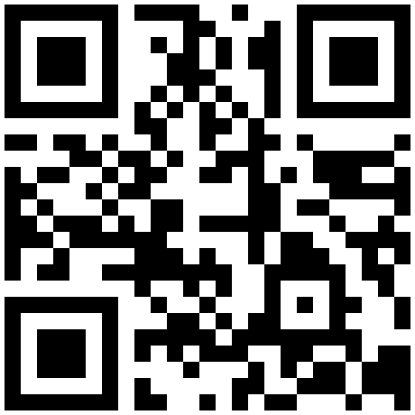

Get-Contact –Identity ‘Presenter’
Blog: mikefrobbins.com (or MrPowerShell.com)
Twitter: @mikefrobbins
LinkedIn: www.linkedin.com/in/mikefrobbins
E-Mail: See mikefrobbins.com/about/
User Group: mspsug.com (or MsPowerShell.com)

